Slide 1
Computer Networks Module- III
The Network Layer

Slide 2
NETWORK LAYER DESIGN ISSUES
Store-and-Forward Packet Switching
Services Provided to the Transport Layer
Implementation of Connectionless Service
Implementation of Connection-Oriented Service
Comparison of Virtual-Circuit and Datagram Networks

Slide 3
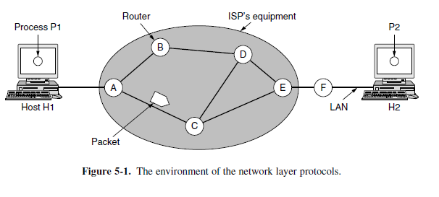
Store-and-Forward Packet Switching

Slide 4
Services Provided to the Transport Layer
The services need to be carefully designed with the following goals in mind:
1. The services should be independent of the router technology.
2. The transport layer should be shielded from the number, type, and topology of the routers present.
3. The network addresses made available to the transport layer should use a uniform numbering plan, even across LANs and WANs.

Slide 5
Implementation of Connectionless Service
If connectionless service is offered, packets are injected into the network individually and routed independently of each other. No advance setup is needed.
In this context, the packets are frequently called datagrams (in analogy with telegrams) and the network is called a datagram network.
If connection-oriented service is used, a path from the source router all the way to the destination router must be established before any data packets can be sent. This connection is called a VC (virtual circuit), in analogy with the physical circuits set up by the telephone system, and the network is called a virtual-circuit network.

Slide 6
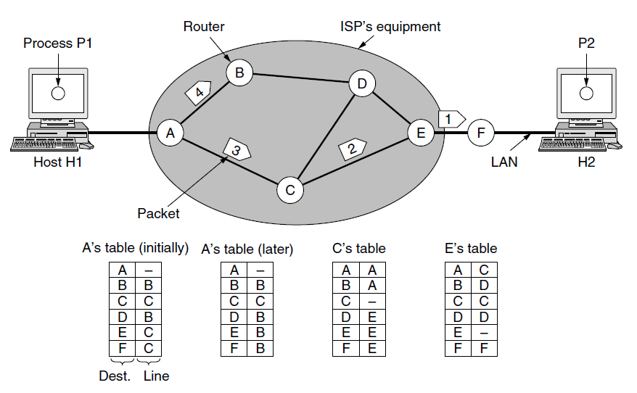
Routing within a datagram network

Slide 7
Cont,
Let us assume for this example that the message is four times longer than the maximum packet size, so the network layer has to break it into four packets, 1, 2, 3, and 4, and send each of them in turn to router A using some point-to-point protocol, for example, PPP.
At this point the ISP takes over. Every router has an internal table telling it where to send packets for each of the possible destinations.
Each table entry is a pair consisting of a destination and the outgoing line to use for that destination.
Only directly connected lines can be used. For example, in Fig. 5-2, A has only two outgoing lines—to B and to C—so every incoming packet must be sent to one of these routers, even if the ultimate destination is to some other router.
A’s initial routing table is shown in the figure under the label ‘‘initially.’’
At A, packets 1, 2, and 3 are stored briefly, having arrived on the incoming link and had their checksums verified.
Then each packet is forwarded according to A’s table, onto the outgoing link to C within a new frame.
Packet 1 is then forwarded to E and then to F.
When it gets to F, it is sent within a frame over the LAN to H2. Packets 2 and 3 follow the same route.

Slide 8
Cont,
The algorithm that manages the tables and makes the routing decisions is called the routing algorithm.
IP (Internet Protocol), which is the basis for the entire Internet, is the dominant example of a connectionless network service.
Each packet carries a destination IP address that routers use to individually forward each packet.
The addresses are 32 bits in IPv4 packets and 128 bits in IPv6 packets.

Slide 9
Implementation of Connection-Oriented Service
For connection-oriented service, we need a virtual-circuit network. Let us see how that works.
The idea behind virtual circuits is to avoid having to choose a new route for every packet sent, as in Fig. Routing within a datagram network.
Instead, when a connection is established, a route from the source machine to the destination machine is chosen as part of the connection setup and stored in tables inside the routers.
That route is used for all traffic flowing over the connection, exactly the same way that the telephone system works.
When the connection is released, the virtual circuit is also terminated.
With connection-oriented service, each packet carries an identifier
telling which virtual circuit it belongs to.

Slide 10
Cont,
As an example, consider the situation shown in Fig. 5-3. Here, host H1 has established connection 1 with host H2.
This connection is remembered as the first entry in each of the routing tables.
The first line of A’s table says that if a packetbearing connection identifier 1 comes in from H1, it is to be sent to router C and given connection identifier 1.
Similarly, the first entry at C routes the packet to E, also with connection identifier 1.
Now let us consider what happens if H3 also wants to establish a connection to H2.
It chooses connection identifier 1 (because it is initiating the connection and this is its only connection) and tells the network to establish the virtual circuit.
This leads to the second row in the tables.
Note that we have a conflict here because although A can easily distinguish connection 1 packets from H1 from connection 1 packets from H3, C cannot do this.
For this reason, A assigns a different connection identifier to the outgoing traffic for the second connection.
Avoiding conflicts of this kind is why routers need the ability to replace connection identifiers
in outgoing packets.
In some contexts, this process is called label switching.

Slide 11
Cont,
An example of a connection-oriented network service is MPLS (MultiProtocol Label Switching).
It is used within ISP networks in the Internet, with IP packets wrapped in an MPLS header having a 20-bit connection identifier or label.
MPLS is often hidden from customers, with the ISP establishing long-term connections for large
amounts of traffic, but it is increasingly being used to help when quality of service is important but also with other ISP traffic management tasks.

Slide 12
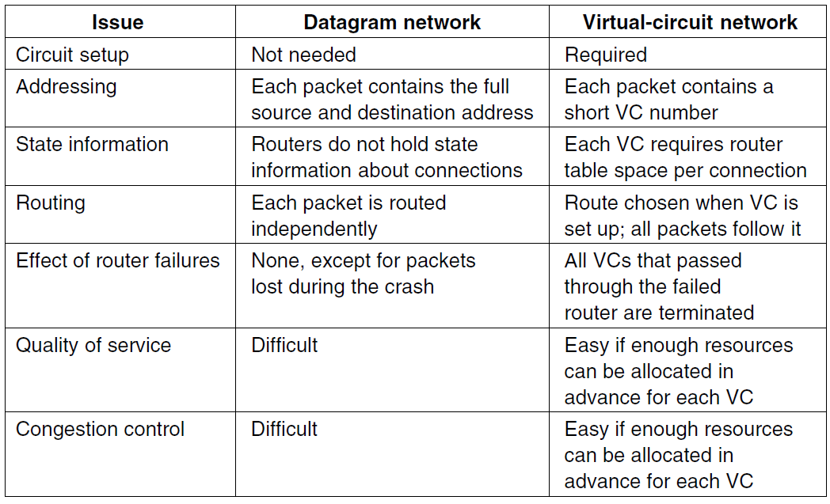
Comparison of Virtual-Circuit and Datagram Networks

Slide 13
ROUTING ALGORITHMS
The main function of the network layer is routing packets from the source machine to the destination machine.
The algorithms that choose the routes and the data structures that they use are a major area of network layer design.
The routing algorithm is that part of the network layer software responsible for deciding which output line an incoming packet should be transmitted on.
If the network uses datagrams internally, this decision must be made a new for every arriving data packet since the best route may have changed since last time.
If the network uses virtual circuits internally, routing decisions are made only when a new virtual circuit is being set up.
Thereafter, data packets just follow the already established route. The latter case is sometimes called session routing because a route remains in force for an entire session (e.g., while logged in over a VPN).

Slide 14
Cont,
Routing, which is making the decision which routes to use, and forwarding, which is what happens when a packet arrives.
One can think of a router as having two processes inside it.
One of them handles each packet as it arrives, looking up the outgoing line to use for it in the routing tables. This process is forwarding.
The other process is responsible for filling in and updating the routing tables.
That is where the routing algorithm comes into play.

Slide 15
Routing algorithms can be grouped into two major classes:
Nonadaptive algorithms do not base their routing decisions on any measurements or estimates of the current topology and traffic.
Instead, the choice of the route to use to get from I to J (for all I and J) is computed in advance, offline,and downloaded to the routers when the network is booted.
This procedure is sometimes called static routing.
Because it does not respond to failures, static routing is mostly useful for situations in which the routing choice is clear.
Adaptive algorithms, in contrast, change their routing decisions to reflect
changes in the topology, and sometimes changes in the traffic as well.
These dynamic routing algorithms differ in where they get their information (e.g., locally, from adjacent routers, or from all routers), when they change the routes (e.g., when the topology changes, or every ΔT seconds as the load changes), and what metric is used for optimization (e.g., distance, number of hops, or estimated transit time).

Slide 16
The Optimality Principle
The optimality principle in computer networks is stated as follows −
It states that if router J is on the optimal path from router I to router K, then the optimal path from J to K also falls along the same route.
It states that if router J is on the optimal path from router I to router K, then the optimal path from J to K also falls along the same route.
To see this, call the part of the route from I to J r1 and the rest of the route r 2. If a route better than r 2 existed from J to K, it could be concatenated with r 1 to improve the route from I to K, contradicting our statement that r 1r 2 is optimal.
As a direct consequence of the optimality principle, we can see that the set of
optimal routes from all sources to a given destination form a tree rooted at the
destination.
Such a tree is called a sink tree and is illustrated in Fig. 5-6(b), where the distance metric is the number of hops.
The goal of all routing algorithms is to discover and use the sink trees for all routers.

Slide 17
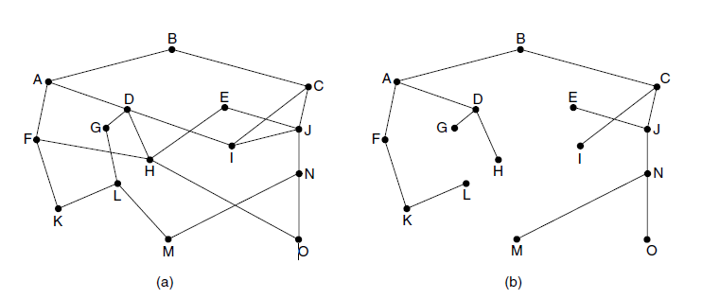
(a) A network. (b) A sink tree for router B.

Slide 18
Cont,
Note that a sink tree is not necessarily unique; other trees with the same path lengths may exist.
If we allow all of the possible paths to be chosen, the tree becomes a more general structure called a DAG (Directed Acyclic Graph).
DAGs have no loops. We will use sink trees as a convenient shorthand for both cases.
Both cases also depend on the technical assumption that the paths do not interfere with each other so, for example, a traffic jam on one path will not cause another path to divert

Slide 19
Shortest Path Algorithm
The idea is to build a graph of the network, with each node of the graph representing a router and each edge of the graph representing a communication line, or link.
To choose a route between a given pair of routers, the algorithm just finds the shortest path between them on the graph.
The concept of a shortest path deserves some explanation. One way of measuring path length is the number of hops.
Using this metric, the paths ABC and ABE in Fig. 5-7 are equally long.
Another metric is the geographic distance in kilometers, in which case ABC is clearly much longer than ABE (assuming the figure is drawn to scale).

Slide 20
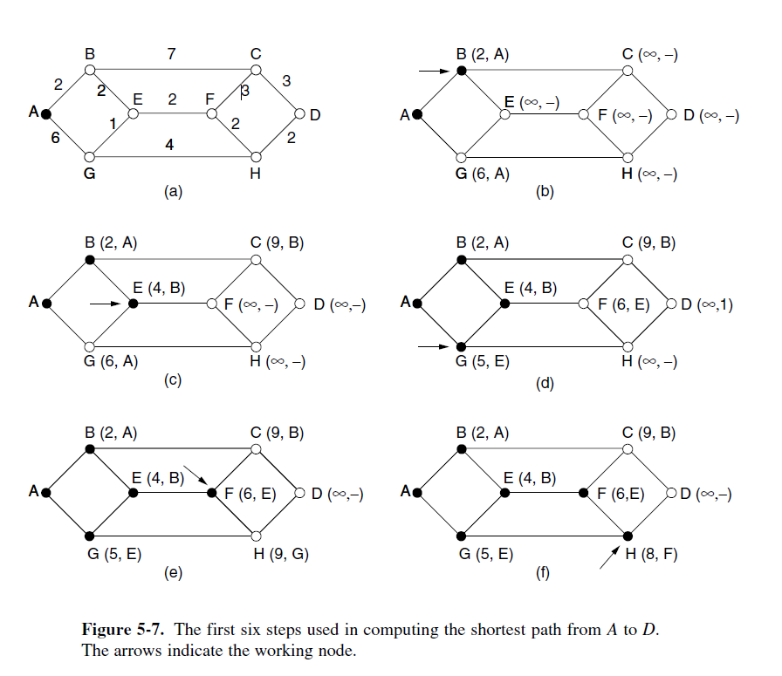
Figure 5-7. The first six steps used in computing the shortest path from A to D. The arrows indicate the working node.

Slide 21
Cont,
Dijkstra (1959) and finds the shortest paths
between a source and all destinations in the network.
Each node is labeled (in parentheses) with its distance from the source node along the best known path.
The distances must be non-negative, as they will be if they are based on real quantities like bandwidth and delay.
Initially, no paths are known, so all nodes are labeled with infinity.
As the algorithm proceeds and paths are found, the labels may change, reflecting better paths.
A label may be either tentative or permanent.
Initially, all labels are tentative.
When it is discovered that a label represents the shortest possible path from the source to that node, it is made permanent and never changed thereafter.

Slide 22
Flooding
When a routing algorithm is implemented, each router must make decisions based on local knowledge, not the complete picture of the network.
A simple local technique is flooding, in which every incoming packet is sent out on every outgoing line except the one it arrived on.
Flooding obviously generates vast numbers of duplicate packets, in fact, an infinite number unless some measures are taken to damp the process.
One such measure is to have a hop counter contained in the header of each packet that is decremented at each hop, with the packet being discarded when the counter reaches zero.
Flooding with a hop count can produce an exponential number of duplicate packets as the hop count grows and routers duplicate packets they have seen before.
A better technique for damming the flood is to have routers keep track of which packets have been flooded, to avoid sending them out a second time.
One way to achieve this goal is to have the source router put a sequence number in each packet it receives from its hosts.
Each router then needs a list per source router telling which sequence numbers originating at that source have already been seen.
If an incoming packet is on the list, it is not flooded.

Slide 23
Cont,
To prevent the list from growing without bound, each list should be augmented by a counter, k, meaning that all sequence numbers through k have been seen.
When a packet comes in, it is easy to check if the packet has already beenflooded (by comparing its sequence number to k; if so, it is discarded.
Furthermore,the full list below k is not needed, since k effectively summarizes it.
First, it ensures that a packet is delivered to every node in the network.
This may be wasteful if there is a single destination that needs the packet,but it is effective for broadcasting information.
Second, flooding is tremendously robust. Even if large numbers of routers are blown to bits (e.g., in a military network located in a war zone), flooding will find a path if one exists, to get a packet to its destination.

Slide 24
Distance Vector Routing
Two dynamic algorithms in particular, distance vector routing and link state routing, are the most popular.
A distance vector routing algorithm operates by having each router maintain a table (i.e., a vector) giving the best known distance to each destination and which link to use to get there.
These tables are updated by exchanging information with the neighbors.
Eventually, every router knows the best link to reach each destination.
The distance vector routing algorithm is sometimes called by other names, most commonly the distributed Bellman-Ford routing algorithm, after the researchers who developed it (Bellman, 1957; and Ford and Fulkerson, 1962).
It was the original ARPANET(Advance Research Project Agency Network) routing algorithm and was also used in the Internet under the name RIP(Routing Information Protocol).

Slide 25
Cont,
In distance vector routing, each router maintains a routing table indexed by, and containing one entry for each router in the network.
This entry has two parts:
The preferred outgoing line to use for that destination and an estimate of the distance to that destination.
The distance might be measured as the number of hops.
The router is assumed to know the ‘‘distance’’ to each of its neighbors.
If the metric is hops, the distance is just one hop.
If the metric is propagation delay, the router can measure it directly with special ECHO packets that the receiver just timestamps and sends back as fast as it can.

Slide 26
Cont,
Each router maintains a Distance Vector table containing the distance between itself and ALL possible destination nodes. Distances,based on a chosen metric, are computed using information from the neighbors’ distance vectors.
Information kept by DV router - Each router has an ID.
Associated with each link connected to a router, there is a link cost (static or dynamic).
Intermediate hops
Distance Vector Table Initialization -Distance to itself = 0
Distance to ALL other routers = infinity number.

Slide 27
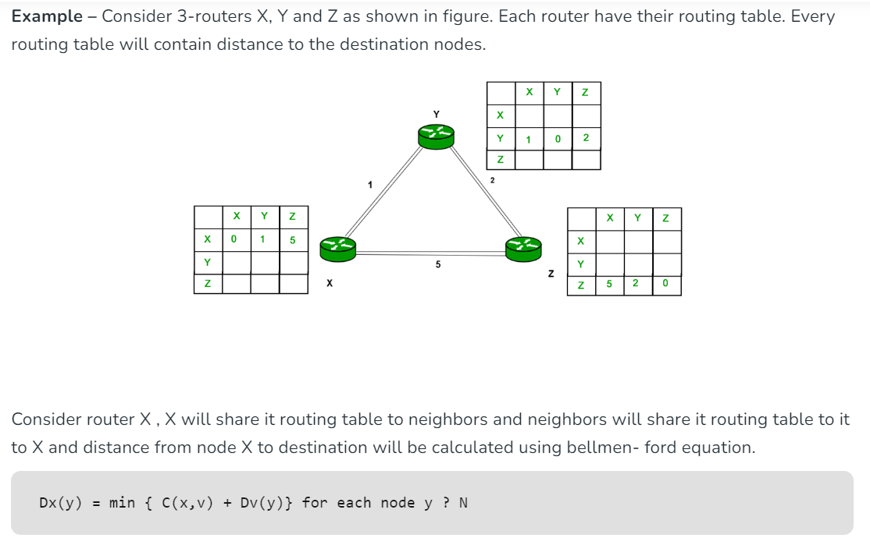
Cont,

Slide 28
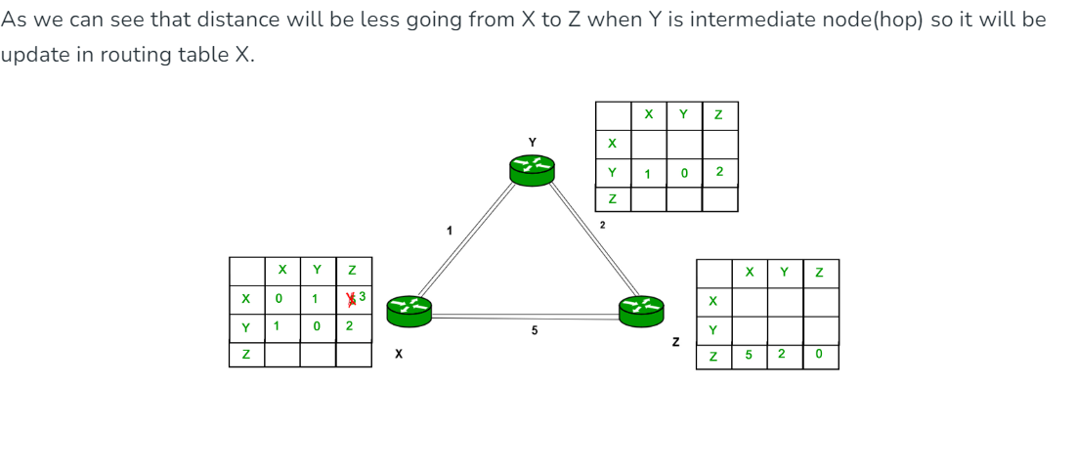
Cont,

Slide 29
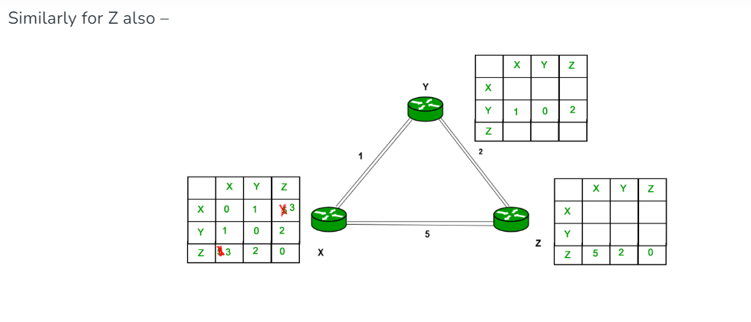
Cont,

Slide 30
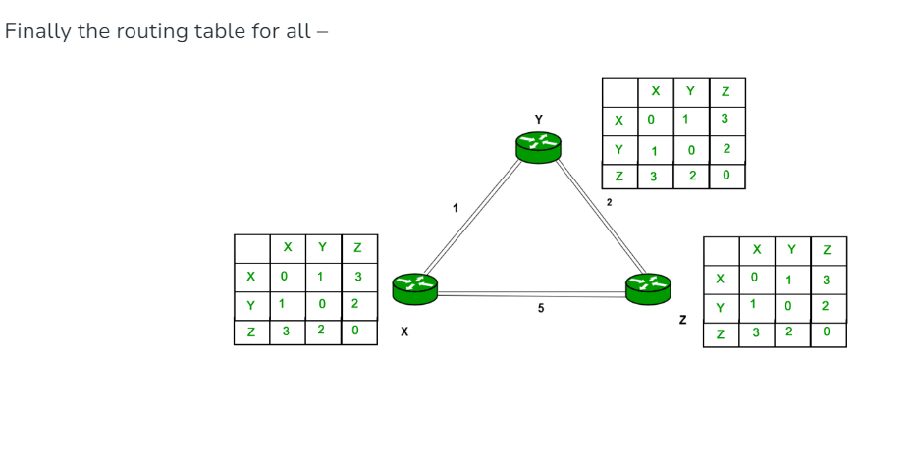
Cont,

Slide 31
Link state routing
Distance vector routing was used in the ARPANET until 1979, when it was replaced by link state routing.
The primary problem that caused its demise was that the algorithm often took too long to converge after the network topology changed (due to the count-to-infinity problem).
Consequently, it was replaced by an entirely new algorithm, now called link state routing.
Variants of link state routing called IS-IS(intermediate system-Intermediate system) and OSPF are the routing algorithms that are most widely used inside large networks and the Internet today.

Slide 32
The idea behind link state routing is fairly simple and can be stated as five parts. Each router must do the following things to make it work:
1. Discover its neighbors and learn their network addresses.
2. Set the distance or cost metric to each of its neighbors.
3. Construct a packet telling all it has just learned.
4. Send this packet to and receive packets from all other routers.
5. Compute the shortest path to every other router.

Slide 33
Calculation of the Shortest Path
Suppose Router A wants to send data to Router C. The shortest path calculation proceeds as follows:
1. Router A floods its LSA containing information about its directly connected links and their associated costs.
2. Router B and Router C receive the LSA and update their LSDBs.
3. Router B calculates its shortest path to Router C as the direct link between them, with a cost of 3 units.
4. Router A calculates its shortest path to Router C as A-B-C, with a total cost of 5 units (A to B: 2 units + B to C: 3 units).
5. Router A updates its routing table, choosing path A-B-C as the most efficient route to reach Router C.

Slide 34
Hierarchical Routing
In hierarchical routing, routers are classified in groups called regions.
Each router has information about the routers in its own region and it has no information about routers in other regions.
So, routers save one record in their table for every other region.
For huge networks, a two-level hierarchy may be insufficient hence, it may be necessary to group the regions into clusters, the clusters into zones, the zones into groups and so on.

Slide 35
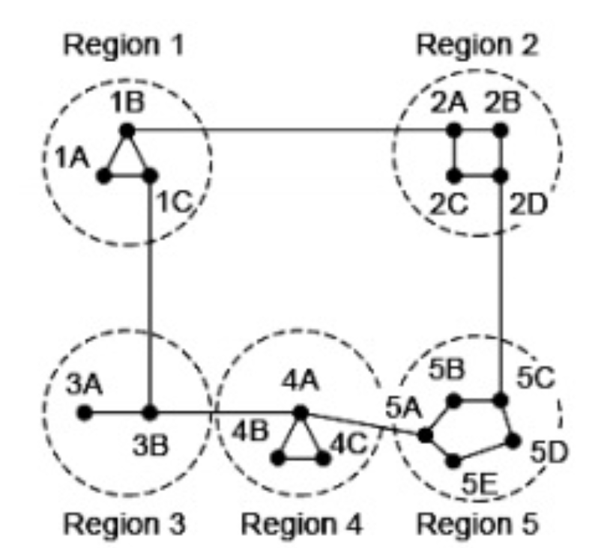
Example

Slide 36
Explanation
Step 1 − For example, the best path from 1A to 5C is via region 2, but hierarchical routing of all traffic to region 5 goes via region 3 as it is better for most of the other destinations of region 5.
Step 2 − Consider a subnet of 720 routers. If no hierarchy is used, each router will have 720 entries in its routing table.
Step 3 − Now if the subnet is partitioned into 24 regions of 30 routers each, then each router will require 30 local entries and 23 remote entries for a total of 53 entries.

Slide 37
CONGESTION CONTROL ALGORITHMS
Too many packets present in (a part of) the network causes packet delay and loss that degrades performance. This situation is called congestion.
The network and transport layers share the responsibility for handling congestion.

Slide 38
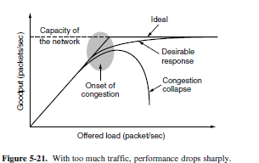

Slide 39
onset of congestion
goodput, which is the rate at which useful packets are delivered by the network.
Hosts send into the network is well within its carrying capacity, the number delivered is proportional to the number sent.
If twice as many are sent, twice as many are delivered.
However, as the offered load approaches the carrying capacity, bursts of traffic occasionally fill up the buffers inside routers and some packets are lost.
These lost packets consume some of the capacity, so the number of delivered packets falls below the ideal curve. The network is now congested.

Slide 40

Approaches to Congestion Control

Slide 41
Contn,
If there is a low-bandwidth link on the path
along which most traffic is directed, congestion is likely
Sometimes resources can be added dynamically when there is serious congestion, for example, turning on spare routers or enabling lines that are normally used only as backups (to make the system fault tolerant) or purchasing bandwidth on the open market.
More often, links and routers that are regularly heavily utilized are upgraded at the earliest opportunity. This is called provisioning and happens on a time scale of
months, driven by long-term traffic trends.

Slide 42
Contn,
Routes can be tailored to traffic patterns that change during the day as network users wake and sleep in different
time zones.
For example, routes may be changed to shift traffic away from
heavily used paths by changing the shortest path weights.
Some local radio stations have helicopters flying around their cities to report on road congestion to make it possible for their mobile listeners to route their packets (cars) around hotspots. This is called traffic-aware routing. Splitting traffic across multiple paths is also helpful.

Slide 43
Cntn,
sometimes it is not possible to increase capacity.
The only way then to beat back the congestion is to decrease the load.
In a virtual-circuit network, new connections can be refused if they would cause the network to becomemcongested. This is called admission control.
when all else fails, the network is forced to discard packets that it cannot deliver. The general name for this is load shedding.
A good policy for choosing which packets to discard can help to prevent congestion collapse.

Slide 44
Broadcast Routing
In some applications, hosts need to send messages to many or all other hosts.
For example, a service distributing weather reports, stock market updates, or live radio programs might work best by sending to all machines and letting those that are interested read the data.
Sending a packet to all destinations simultaneously is called broadcasting.

Slide 45
Multidestination routing, in which each packet contains either a list of destinations or a bit map indicating the desired destinations.
When a packet arrives at a router, the router checks all the destinations to determine the set of output lines that will be needed. (An output line is needed if it is the best route to at least one of the destinations.)
The router generates a new copy of the packet for each output line to be used and includes in each packet only those destinations that are to use the line.

Slide 46
Reverse path forwarding
When a broadcast packet arrives at a router, the router checks to see if the packet arrived on the link that is normally used for sending packets toward the source of the broadcast.
If so, there is an excellent chance that the broadcast packet itself followed the best route from the router and is therefore the first copy to arrive at the router.
This being the case, the router forwards copies of it onto all links except the one it arrived on.
If,however, the broadcast packet arrived on a link other than the preferred one for reaching the source, the packet is discarded as a likely duplicate.

Slide 47
Cont,
A way to send messages to well-defined groups that are numerically large in size but small compared to the network as a whole.
Sending a message to such a group is called multicasting, and the routing algorithm used is called multicast routing.
Multicast routing schemes build on the broadcast routing schemes we have already studied, sending packets along spanning trees to deliver the packets to the members of the group while making efficient use of bandwidth.
However, the best spanning tree to use depends on whether the group is dense, with receivers scattered over most of the network, or sparse, with much of the network not belonging to the group.

Slide 48
Traffic-Aware Routing
These schemes adapted to changes in topology, but not to changes in load.
The goal in taking load intoaccount when computing routes is to shift traffic away from hotspots that will be the first places in the network to experience congestion.
The most direct way to do this is to set the link weight to be a function of the (fixed) link bandwidth and propagation delay plus the (variable) measured load or average queuing delay.
Least-weight paths will then favor paths that are more
lightly loaded, all else being equal.

Slide 49
Cont,
Two techniques can contribute to a successful solution.
The first is multipath routing, in which there can be multiple paths from a source to a destination.
In our example this means that the traffic can be spread across both of the East to West links.
The second one is for the routing scheme to shift traffic across routes slowly enough that it is able to converge.
Given these difficulties, in the Internet routing protocols do not generally adjust their routes depending on the load.
Instead, adjustments are made outside the routing protocol by slowly changing its inputs. This is called traffic engineering.

Slide 50
Admission Control
One technique that is widely used in virtual-circuit networks to keep congestion at bay is admission control.
The idea is simple: do not set up a new virtual circuit unless the network can carry the added traffic without becoming congested.
Thus, attempts to set up a virtual circuit may fail. This is better than the alternative, as letting more people in when the network is busy just makes matters worse.
By analogy, in the telephone system, when a switch gets overloaded it practices admission control by not giving dial tones.

Slide 51
Traffic is often described in terms of its rate and shape.
The problem of how to describe it in a simple yet meaningful way is difficult because traffic is typically bursty—the average rate is only half the story.
For example, traffic that varies while browsing the Web is more difficult to handle than a streaming movie with the same long-term throughput because the bursts of Web traffic are more likely to congest routers in the network.
A commonly used descriptor that capture this effect is the leaky bucket or token bucket.
A leaky bucket has two parameters that bound the average rate and the instantaneous burst size of traffic.
Since leaky buckets are widely used for quality of service.

Slide 52
Traffic Throttling
In the Internet and many other computer networks, senders adjust their transmissions to send as much traffic as the network can readily deliver.
In this setting, the network aims to operate just before the onset of congestion.
When congestion is imminent, it must tell the senders to throttle back their transmissions and slow down.
This feedback is business as usual rather than an exceptional situation.
The term congestion avoidance is sometimes used to contrast this operating point with the one in which the network has become (overly) congested.

Slide 53
Load Shedding
Load shedding is a fancy way of saying that when routers are being inundated by packets that they cannot handle,
they just throw them away.
The term comes from the world of electrical power generation, where it refers to the practice of utilities intentionally blacking out certain areas to save the entire grid from collapsing on hot summer days when the demand for electricity greatly exceeds the supply.
The key question for a router drowning in packets is which packets to drop.
The preferred choice may depend on the type of applications that use the network.

Slide 54
Internetworking Network Layer in Internet.
When two or more networks are connected to form an internetwork, or more simply an internet.
Bob Metcalfe postulated that the value of a network with N nodes is the number of connections that may be made between the nodes, or N2 (Gilder, 1993).
This means that large networks are much more valuable than small networks because they allow many more connections, so there always will be an incentive to combine smaller networks.
The Internet is the prime example of this interconnection. (We will write Internetwith a capital ‘‘I’’ to distinguish it from other internets, or connected networks.)
The purpose of joining all these networks is to allow users on any of
them to communicate with users on all the other ones.

Slide 55
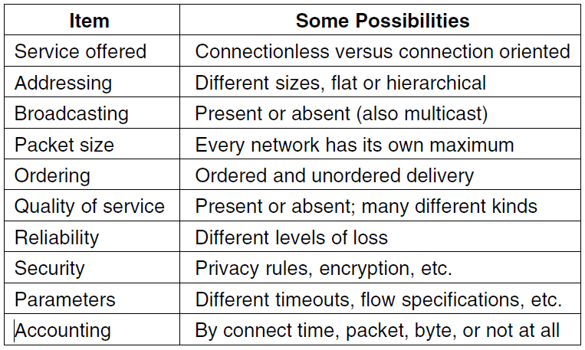
How Networks Differ

Slide 56
How Networks Can Be Connected
There are two basic choices for connecting different networks:
we can build devices that translate or convert packets from each kind of network into packets for each other network, or, like good computer scientists
we can try to solve the problem by adding a layer of indirection and building a common layer on top of the different networks.

Slide 57
Cont,
Several different devices that connect networks, including repeaters, hubs, switches, bridges, routers, and gateways.
Repeaters and hubs just move bits from one wire to another. They are mostly analog devices and do not understand anything about higher layer protocols.
Bridges and switches operate at the link layer. They can be used to build networks, but only with minor protocol translation in the process, for example, between 10, 100 and 1000 Mbps Ethernet
switches.
Our focus in this section is interconnection devices that operate at the network layer, namely the routers.
Gateways, which are higherlayer interconnection devices.

Slide 58
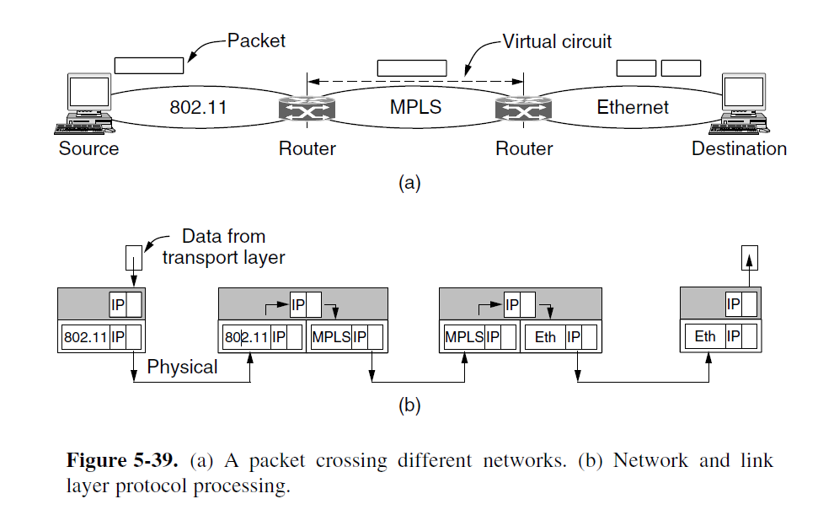
Cont,

Slide 59
Tunneling
Handling the general case of making two different networks interwork is exceedingly difficult.
However, there is a common special case that is manageable even for different network protocols.
A technique of inter-networking called Tunneling is used when source and destination networks of the same type are to be connected through a network of different types. Tunneling uses a layered protocol model such as those of the OSI or TCP/IP protocol suite.
So, in other words, when data moves from host A to B it covers all the different levels of the specified protocol (OSI, TCP/IP, etc.) while moving between different levels, data conversion (Encapsulation) to suit different interfaces of the particular layer is called tunneling.

Slide 60
Internetwork Routing
Two-level routing algorithm.
intradomain or interior gateway protocol
Across the networks that make up the internet,an interdomain or exterior gateway protocol is used.
In the Internet, the interdomain routing protocol is called BGP (Border Gateway Protocol).
Since each network is operated independently of all the others, it is often referred to as an AS (Autonomous System).

Slide 61
Packet Fragmentation
Fragmentation is done by the network layer when the maximum size of datagram is greater than maximum size of data that can be held in a frame i.e., its Maximum Transmission Unit (MTU). The network layer divides the datagram received from the transport layer into fragments so that data flow is not disrupted.

